Slide 1

G2M Insight for Cab Investment Firm
Exploratory Data Analysis and Hypothesis Results
Aug 19, 2022

Slide 2
Agenda
Background
Data & Approach
EDA
Recommendations

Slide 3
Background of G2M Strategy and Cab Industry
XYZ is planning for an investment in Cab industry due to remarkable growth in the Cab Industry in last few years and multiple key players in the market.
Objective:
As per the Go-to-Market(G2M) strategy, XYZ want to
1. understand the market before taking final decision.
2. identify the right company to make their investment.

Slide 4
Data & Approach
Cab_Data.csv
Customer_ID.csv
Transaction_ID.csv
City.csv
us_holiday.csv
Data:
12 Features
Timeframe of the data: 2016-01-02 to 2018-12-31
Total data points :359,392
Approach:
•Used the foreign keys (transaction ID and customer ID) as references to join interrelated data into a single table with every single row including all the attributes.
•Used linear regression to roughly predict the profit in 2019
•Used Polynomial regression to roughly predict the customer in 2019
Assumptions:
Profit of each ride is calculated by subtracting Price Changed with Cost of Trip.
Total number of customers of both cab service is larger than Customer_ID.csv and we also found redundant fields in the Customer_ID dataset. We assumed that customers can be other cab customers as well (including Yellow and Pink cab) while some customers didn’t use any cab service during the study time.
Users feature of City.csv is treated as number of cab users in the city. We have assumed that this can be other cab users as well (including Yellow and Pink cab).
Final cab data

Slide 5
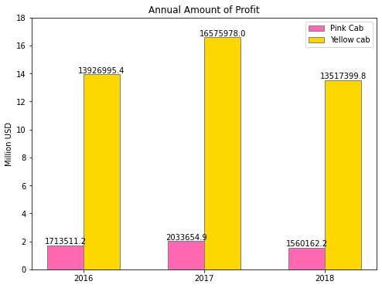
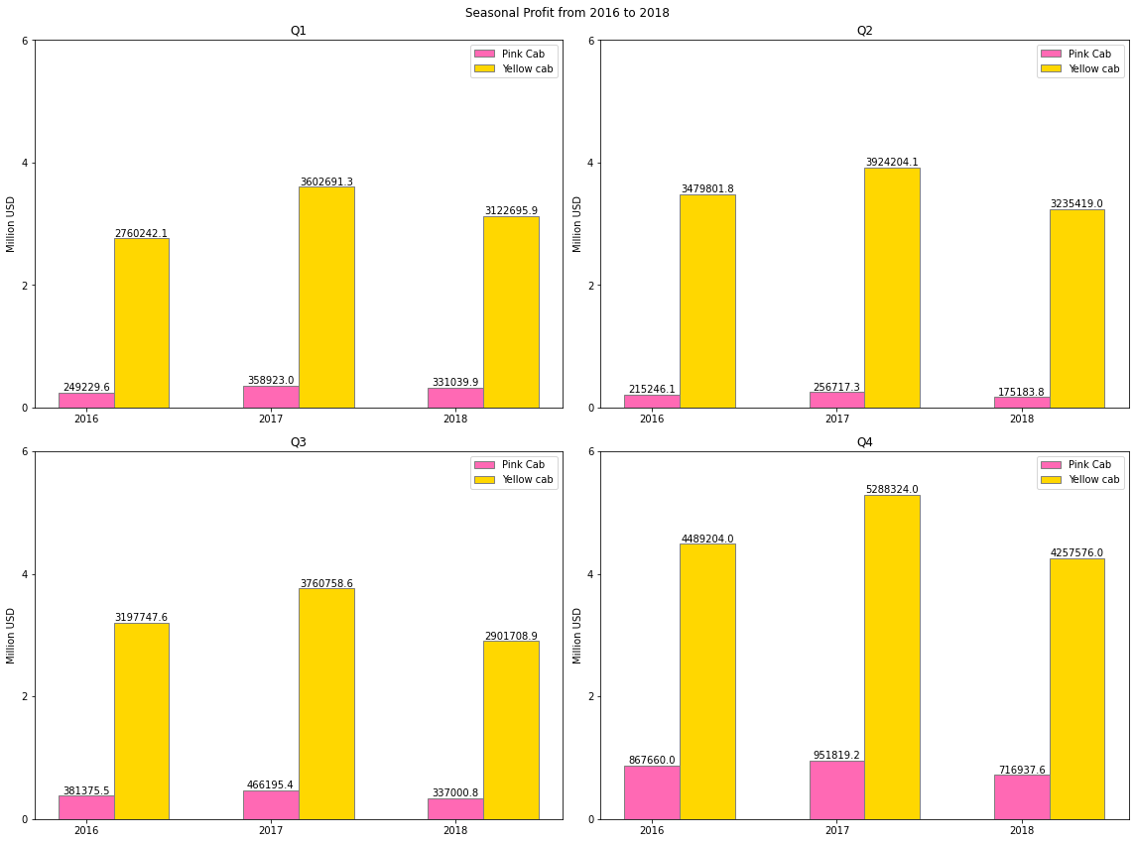
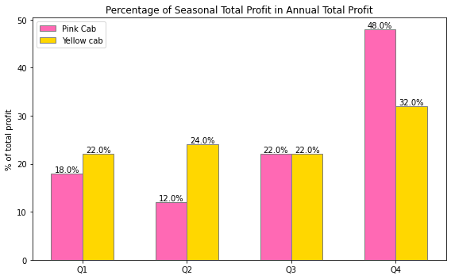
Annual and seasonal profit
Yellow Cab had more profit than Pink Cab in all seasons and also annual pattern.

Slide 6
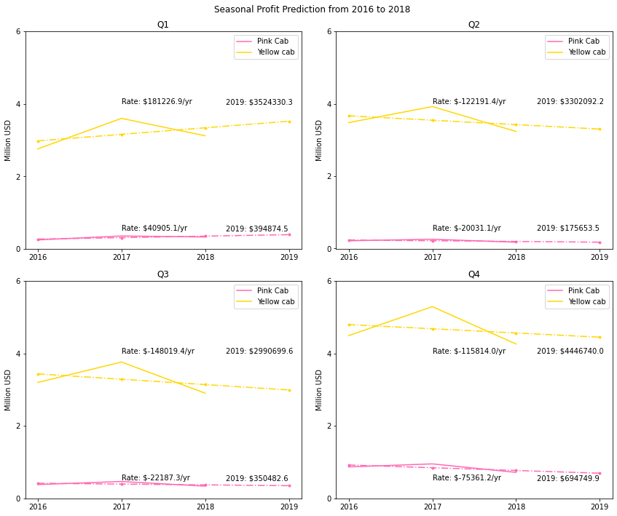
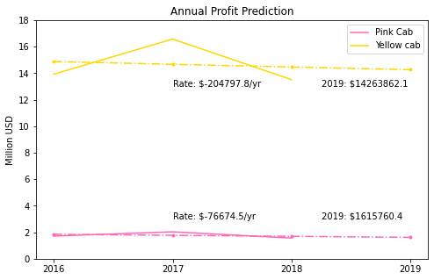
Profit prediction
Profit prediction using linear regression can help estimate the trend of profit from 2016 to 2018 and provide a rough estimate of profit in 2019.
Yellow cab shows a larger annual decrease trend in profit than the Pink cab.
Both cabs had an increase trend of profit in the 1st season. Yellow Cab shows a larger increase.

Slide 7
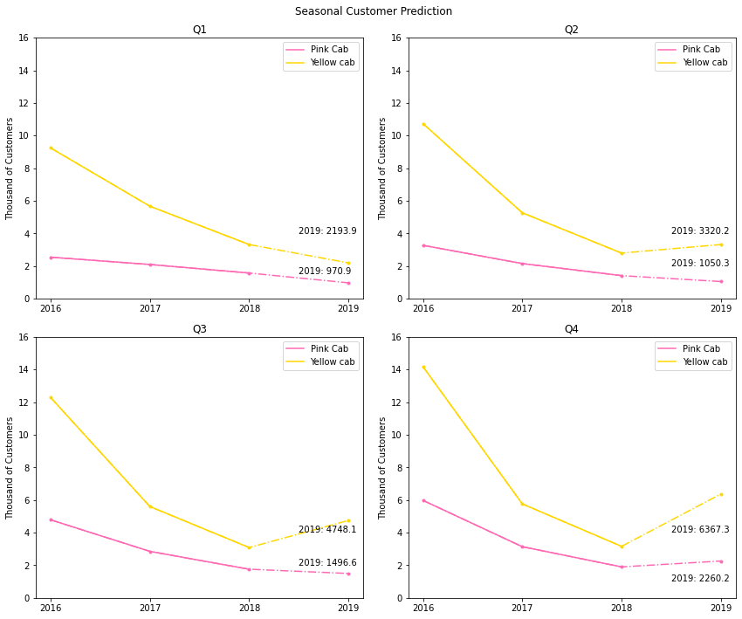
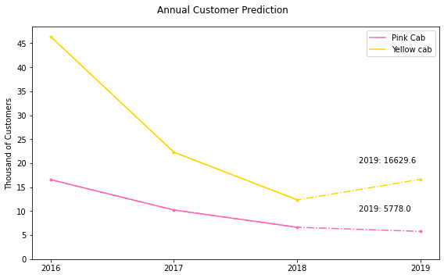
Customer prediction
Yellow Cab had more customers than the Pink Cab.
Based on the polynomial regression, the yellow cab can expect an faster return of customers in the following year.

Slide 8
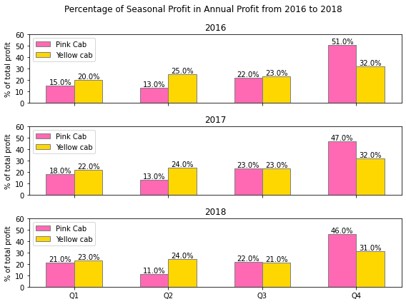
Fraction of seasonal profit each year
It shows that for both cab services, profit made in the 4th season has the largest partion of their annual profit.
The seasonal profit except the 4th season of Pink Cab takes smaller fraction than Yellow Cab.

Slide 9
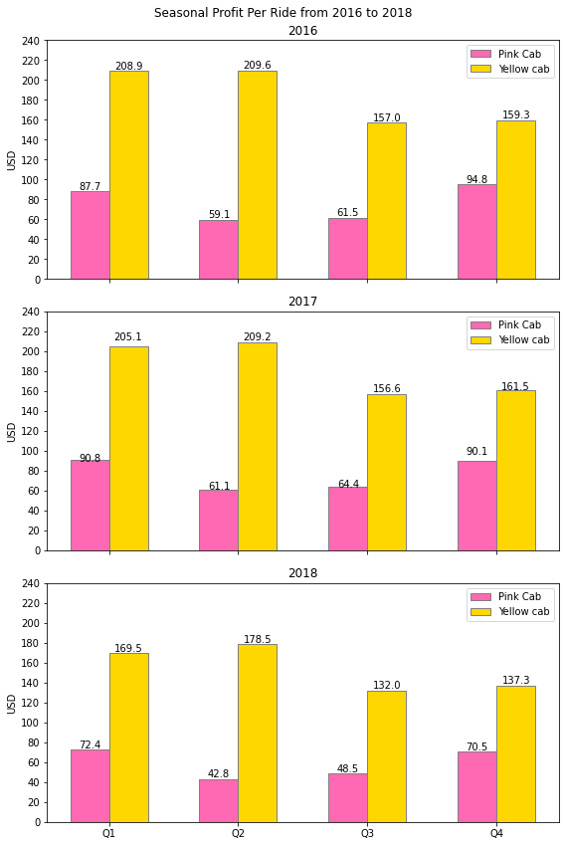
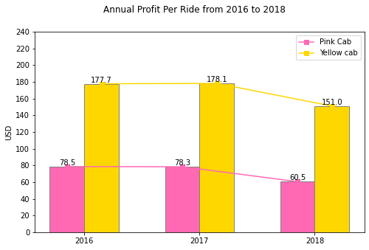
Annual and seasonal profit per ride
Based on the seasonal averaged profit per ride, averaged profit per ride is larger in the first half year for the Yellow Cab, while it is more profitable for the Pink Cab at the beginning and end of the year.
Based on the annual averaged profit per ride from 2016 to 2018, it is decreasing of profit for Pink Cab service, while a slight increase in 2016-2017 for the Yellow Cab service, and a much larger decrease in 2017-2018.

Slide 10
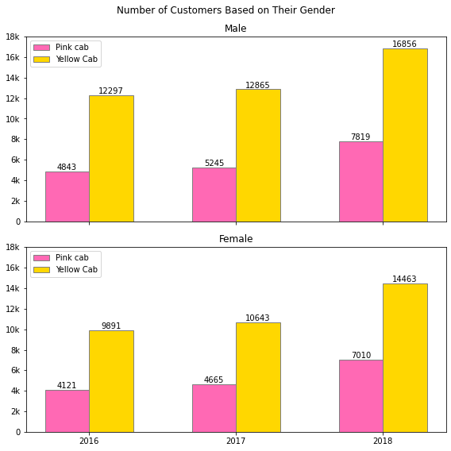
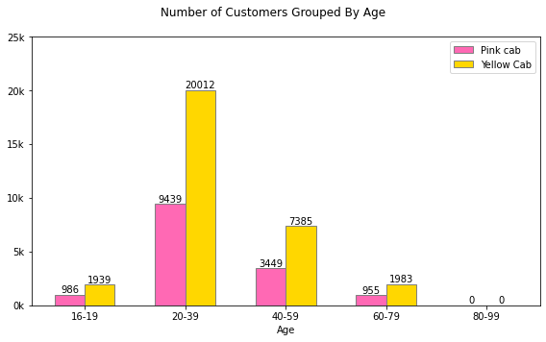
Distribution of customers based on gender and age
To better understand the market,
Customers of both gender are increasing from 2016 to 2018.
Most of the customers accumulated within the age range of 20-39, and then 40-59 for both cab services.

Slide 11
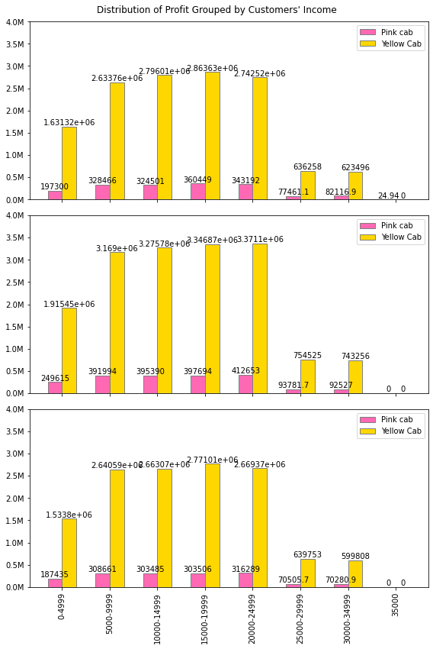
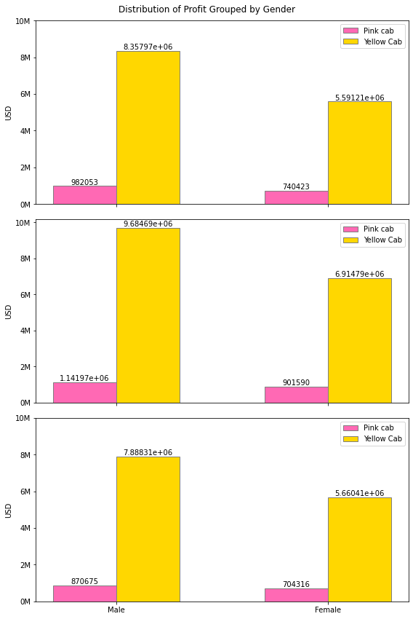
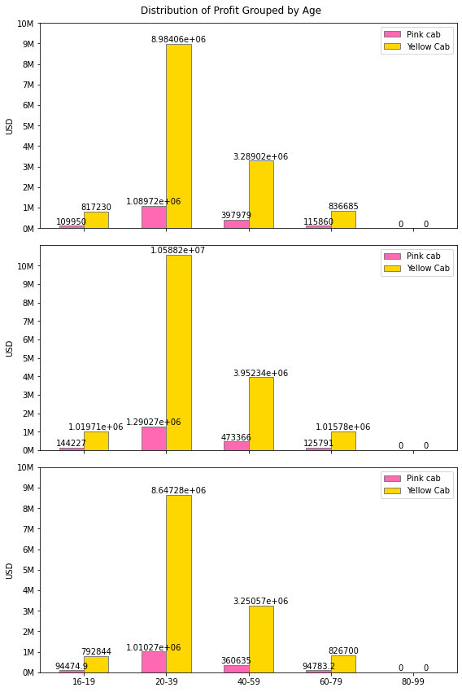
Distribution of profit based on customers’ gender, age and income
Male customers contributed slightly more profit for both of the cab service.
Customers aged between 20-39 contributed more to the total profit.
Customers with income between $5000-24999 /mon contributed more to the total profit.

Slide 12
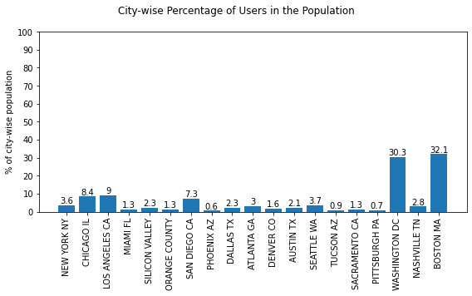
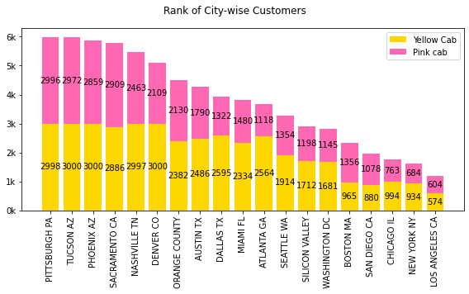
City-wise users and customers
Washington DC and Boston MA had more fraction of cab users than other cities.
By ranking the customers, Pink Cab had more customers in Sacramento CA, Boston MA, San Diego CA, and Los Angeles CA than Yellow Cab.

Slide 13
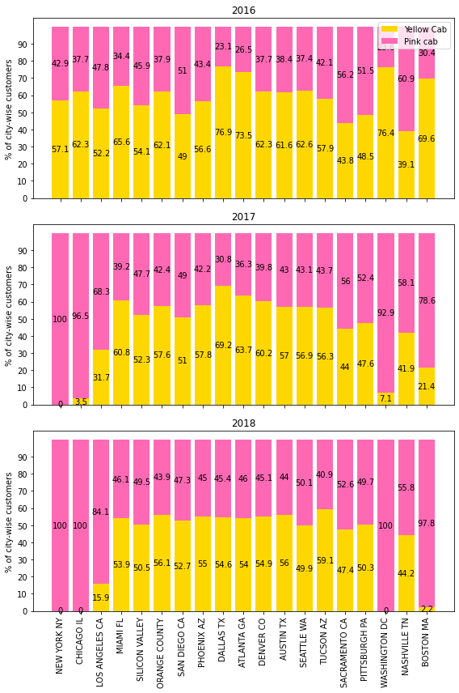
Time series of the fraction of city-wise customers
Pink Cab has been gradually taking the advantage of the market in New York NY, Chicago IL, Los Angeles CA, Washington DC and Boston MA.
Pink Cab gained small increase of market share in some other cities including Miaml FL, Silicon Valley, Orange County, Phinex AZ, Dallas TX, Atlanta GA, Denver CO, Austin TX and Seattle WA.

Slide 14
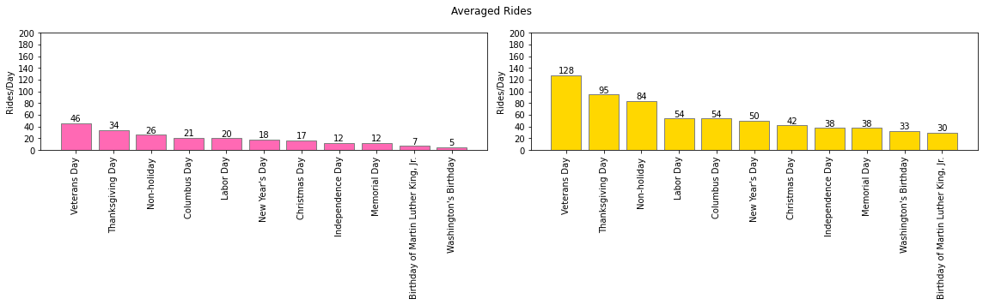
Holiday/nonholiday impacts on daily averaged rides
Comparing the averaged number of rides on holiday and non-holiday for both cab services, Yellow Cab had more rides averaged on a day than Pink Cab.
It also shows that only on Veteran Day and Thanksgiving Day will the averaged rides be more than non-holiday averaged number of rides or that on other holidays.

Slide 15
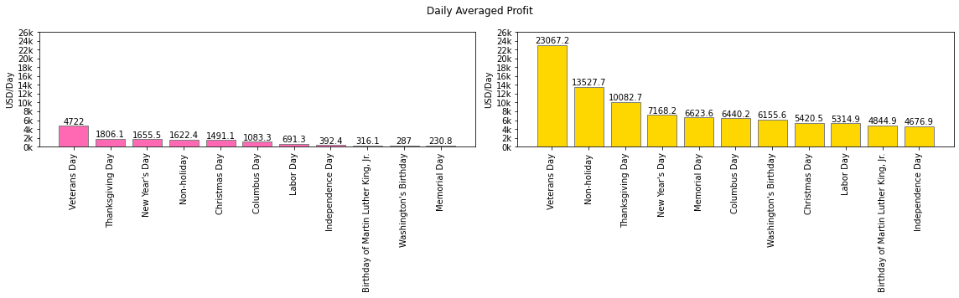
Holiday/nonholiday impacts on daily averaged profit
Comparing the averaged number of rides on holiday and non-holiday for both cab services, Yellow Cab had more profit averaged on a day than Pink Cab.
On Veteran day, Thanksgiving day and New Year’s day will the averaged profit be larger than that on non-holiday for Pink Cab.
Only on Veteran day will the averaged profit be larger than that on non-holiday for Yellow Cab.

Slide 16
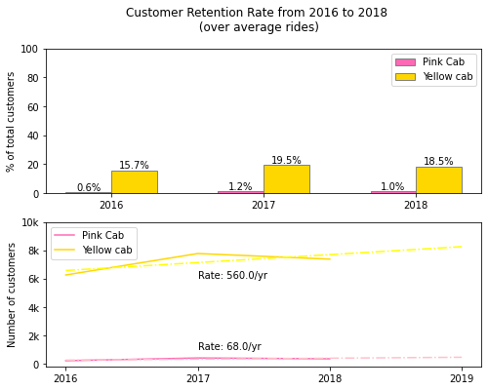
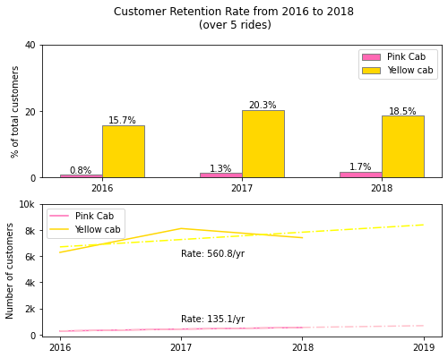
Customer Retention
There’s a larger fraction of customers who made either more than averaged rides or more than 5 rides in the Yellow Cab than Pink Cab.
The number of customers counted into the customer retention had an increase trend in both cab service.

Slide 17
Outline of building a comprehensive model for prediction the customers and profit
LOST INFORMATION ARE MARKED
--> means “can predict”, -()-> means “need () to predict”
Distribution of customers * change rate (influenced by income, age, gender and total users) * holiday/nonholiday rate * ROI (Return on Investment) --> customer prediction
Customer retention * customer prediction * holiday/nonholiday ride --> ride prediction
Ride prediction * profit per ride * holiday/nonholiday profit --> profit prediction
Profit prediction -(ROI)-> customer prediction
In different city,
City-wise rides * nation-wise customer prediction * customer retention * holiday/nonholiday rate * other city-wise factors other than population (e.g. economy, traffic, distribution, city’s structure) * ROI --> city-wise customer/ride
City-wise rides * customer retention * averaged profit per ride* holiday/nonholiday rate * other city-wise factors other than population (e.g. economy, traffic, distribution, city’s structure) --> city-wise profit prodiction
City-wise profit prodiction -(ROI)-> city-wise customer/ride

Slide 18
Recommendations
We have evaluated both the cab companies on following points:
Customer Reach : Yellow cab has higher customer reach in 25 cities while Pink cab has higher customer reach in 4 cities.
Customer Retention: We have analyzed this in two segments : above averaged number of drive each year and at least 5 drive with the same cab company. Based on our results, Yellow cab was doing far better than Pink cab in both these segments.
Age and Gender Wise Reach : Yellow cab has customer with age ranging from 16 to 79 and it’s been observed that it’s most popular in 20-39 age group. Male customers in Yellow Cab contribute 6 times more than the male customer group in Pink Cab, and 8 times more for the female group.
Average Profit per Ride: Yellow cab’s average profit per ride is almost 3.5 times the average profit per ride of the Pink cab in all seasons and every year.
Income wise Reach : Both the cabs are very popular in high and medium income class but here also Yellow cab is performing better than Pink cab in offering their services to all the three income class group (low, medium and high)
Ride count and Profit Prediction : Both companies had loss in the profit and number of customers. Even though the amount of Yellow cab’sforcasted profit loss is more than Pink cab’s, Yellow cab’s is around 1.52% while Pink cab’s loss is 4.91%. Therefore, Pink cab is facing more loss.
On the basis of above point , we will recommend Yellow cab for investment.

Slide 19
Thank You

